Slide 1
Microtesting Being smarter about how we test by embracing simplicity and continuous improvement.
Rob Moore
Principal Consultant, Readify
Matt Davies
Lead Consultant, Readify
Notes:
(Rob to start)
AKA: How we set fire to the testing pyramid while maintaining confidence

Slide 2














Notes:
DDD Melbourne 2015 Sponsors

Slide 3
Why microtesting?
Because we wanted to be part of the cool club
Because we wanted to harness our inner hipster
Because we have been writing less tests,
but getting more out of it
Notes:
(Rob)
Let’s get the burning question out of the way…
On a more serious note: We’ve been finding that with the testing strategies we’ve been using lately we’ve been writing less tests and getting more out of it.

Slide 4
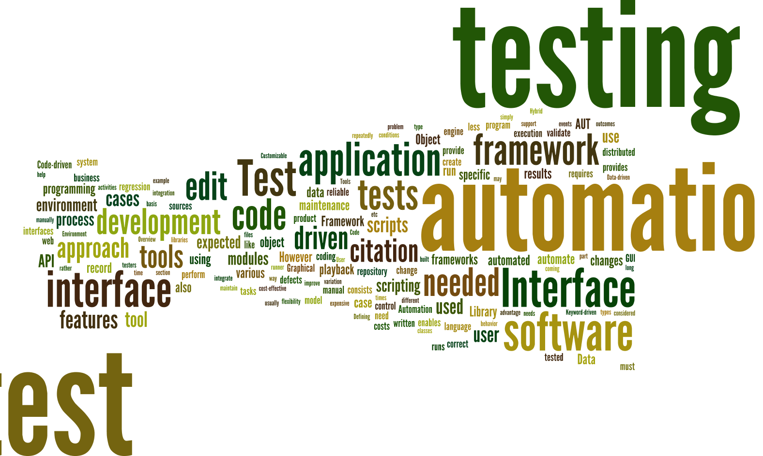
Notes:
(Matt)
Created by piping http://en.wikipedia.org/wiki/Test_automation into http://www.wordle.net/
As consultants we get to move within a number of different projects and industries.
Seen a lot of approaches over the last few years and seen what a lot of companies have done these
Experimented with a number of different approaches ourselves
Done a lot of research into what people are saying and doing

Slide 5

Notes:
(Matt)
http://en.wikipedia.org/wiki/Landfill
We’ve seen (and written) some awful, awful test code
Made our fair share of mistakes and learned a lot

Slide 6
Theory
(sorry)
p.s. don’t worry, we promise we will deliver and burn the testing pyramid – keep an eye out for it
Notes:
(Matt)
In our dedication to improving our testing, we’ve made an number of realisations and we thought it would be helpful to explain these before we go into our current approach.

Slide 7
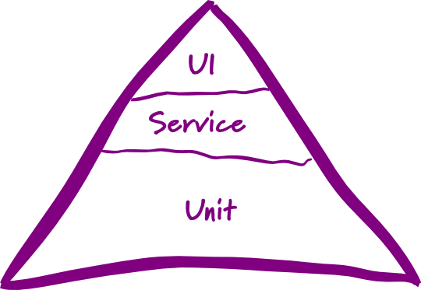
Testing pyramid
☹
Notes:
(Matt)
http://martinfowler.com/bliki/TestPyramid.html
This is the testing pyramid that you probably first heard about at uni – you have a breakdown of tests that looks something like this:
Most organisations we go into either have limited testing, or have an approach based on something like this. We see this everywhere.
Mostly low level unit tests
A smaller of number of service level or integration tests
An even smaller number of UI or system level tests
[transition]
We hate the testing pyramid. There are 3 Problems we have with it:
You have to care about the type of tests rather than what confidence you’re getting from them – how many people waste time arguing if a test is unit/integration/etc.? That’s a WASTE OF TIME
One-size-fits-all approach for all your projects that doesn’t give you the flexibility we feel you need across projects
It also doesn’t take into account the relationship between speed and confidence…

Slide 8

Speed
?
vs confidence
Notes:
(Rob)
https://www.flickr.com/photos/davidvillarreal/8732245026/
Speed vs confidence
By speed we mean speed of feedback – how quickly do we get feedback as to whether or not the codebase is ok
Confidence – how much certainty do your tests give you that your software is okay

Slide 9
* Ignoring other factors – this is just looking
at speed and confidence
Speed
“unit” tests
real database calls
UI testing
Manual testing
Confidence
Notes:
(Rob)
Automated or UI testing – all other considerations aside (human error, reliability etc) those two forms of testing take a lot of time to run but give you a lot of confidence the system is working because they act as a real user and exercise the entirety of the system as a user would.
Unit tests – super quick feedback but you aren’t exercising the system as a user is – so you aren’t as sure that all the pieces are working together correctly.

Slide 10
Jimmy Bogard’s testing pyramid
😐
Slow as
hell
Slow
Fast
Notes:
(Rob)
https://vimeo.com/68390508
Jimmy Bogard presented an alternative testing pyramid in his Holistic Testing talk at NDC Oslo in 2013.
Jimmy provides a breath of fresh air when throwing away the testing pyramid (and all the conflicting definitions of unit, integration, etc. tests) in favour of a pyramid that has a small number of “slow as hell tests”, a slightly larger number of “slow” tests and a lot of “fast” tests.
This is great as it helps us start to focus on something important about the tests – the speed of feedback – but doesn’t go far enough in my opinion since it doesn’t take confidence into account and is still a one-size-fits all strategy.

Slide 11

Our testing pyramid
☺
Notes:
(Rob)
BURN IT TO THE GROUND!!
(Matt)
We fundamentally disagree with the concept of a testing pyramid – as we’ve previous said, it’s too rigid and doesn’t you offer any flexibility between projects.

Slide 12

Our testing pyramid
☺
Notes:
Matt
(we really mean it, this is serious)

Slide 13
“The ultimate goal here is to ship code it’s not to write tests; tests are just a means to the end of shipping code.” “I can have 100% code coverage and have noone use my product and I can have 0% code coverage and it’s a huge success; there is no correlation between the two things.”
Jimmy Bogard
Confidence, rather than coverage, is key
Notes:
(Matt)
Quoted from his Holistic Testing talk at NDC 2013.
https://vimeo.com/68390508

Slide 14
“Testing is the process of evaluating a product by learning about it through experimentation, which includes to some degree: questioning, study, modelling, observation and inference. All the automated tests in the pyramid cannot be classed as an evaluation of a product by learning via experimentation. They are essentially CHECKS.”
Hamish Tedeschi, MagenTys
We need to accelerate the time to get to real users
Notes:
(Rob)
https://prezi.com/c5hrzba-wmxb/magentys-devops/
http://www.meetup.com/Perth-Agile-Testing/events/212586832/
In a continuous delivery world where we want to innovate and rapidly release software incrementally we can deal with uncertainty about what users want by embracing “testing” in this context. But in order to achieve this and make full use of our investment in continuous delivery we need to decrease the feedback loop to real users and then take advantage of that by getting quantitative and qualitative feedback.

Slide 15
Speed of release
You can only release when you meet your minimum confidence level.
Speed of release
Fear of refactoring
Manual regression testing
Slow, brittle tests
Lot’s of time spent testing
Automated “checks”
Notes:
(Rob)

Slide 16
tl;dr * Speed and confidence are inversely proportional * Testing pyramid is too rigid – we can be smarter * Speed up releases via checks; then facilitate real testing
Notes:
(Matt)

Slide 17
So, how do we decide on a testing strategy then?
Notes:
(Rob)

Slide 18
“Challenge yourself to start simple then inspect and adapt”
Notes:
(Rob)

Slide 19
Setting a testing strategy
Challenge yourself to set a minimum confidence level that is as low as possible
Create a testing strategy that meets that confidence level as fast as possible
Adjust the testing strategy over time based on observations (inspect and adapt)
Notes:
(Matt)
Go back to original point on confidence.
1. Most stakeholders will say 100% confidence but that actually means you’ll never get anything shipped out the door. Being pragmatic, we actually want to challenge ourselves to set our confidence level as low as possible for our business needs. in combination with techniques like continuous delivery, we can optimise our testing strategy to be able to react quickly and efficiently to mistakes that do happen. Really a business decision rather than a technical decision because you’re trading speed vs confidence, and this is something a business person will care about – they care about speed out to users vs likelihood that it will break.
2. Increases agility and supports CD
3. Your first attempt at this doesn’t have to be right – but it should be simple.
How many bugs are getting to production?
How fast is your team delivering features?
How confident or scared are you when your product is pressing the button to deploy to production?

Slide 20
Is that an oversimplification?
Yes and no.
Notes:
(Rob)
So you might ask – Is that a simplification? Surely you don’t use one type of test (the fastest possible for a confidence level) across your whole app.
[Reveal]
Yes and no.
Confidence level needed will likely change across different parts of the application.
But, we typically start with a broad brush testing strategy and let the inspect and adapt cycle run it’s course. Besides, in most of the apps we work on the majority of the application will be very similar, and then a few parts of it will be “special” and need different treatment. That’s where the inspect and adapt bit comes in to save the day.

Slide 21
Enterprise Grade Testing™
Keep it nimble
Make it per-project
Actually change it
Notes:
(Rob, Matt)
So, because we work for enterprises, we need enterprise-driven right?
We need to set our strategy, show it at CAB and then apply it synergistically across the organization so they are all consistent.
Then we can hire a separate team of testers to roll out the testing strategy across all teams and keep the developers honest because we don’t trust them…
NO. Just stop. Srsly.

Slide 22
Subcutaneous testing
Notes:
(Matt)
A major part of the strategy that we have been using involves a technique called Subcutaneous Tests

Slide 23
UI
MVC Controller / MVVM View etc.
Subcutaneous Test
Domain / Services / Repositories etc.
Database
External System
Notes:
(Matt)
One-level below the UI e.g. MVC controller
Full stack of production dependencies wired in
Application-owned datasources wired in
External dependencies mocked out
Good speed/confidence balance between all UI tests and all “unit” tests

Slide 24
Advantages
Testing behaviour → acceptance criteria → executable specification
High amount of confidence
Reasonably fast without the fragility of UI tests
Refactoring friendly ☺
Less: tedious mocking code
Notes:
(Matt)

Slide 25

Silver bullet!?
Notes:
(Rob)
https://www.flickr.com/photos/eschipul/4160817135
Not a silver bullet, there are some disadvantages and some limitations you need to be aware of. There are ways of working around or dealing with them though.

Slide 26
Disadvantages
Hard to get complete coverage of complex code
Combinatorial explosion
Hard to know why broken
Multiple test failures
Test complexity – lots of moving parts
Notes:
(Rob)
Explain the points, then look at the ways around them:
Complex code – use a different type of test (or combine)
Hard to know why broken – stack traces and the debugger are you friend along with good code organization and small number of layers in your code, your test tooling can help too –the BDD framework I use makes it easier to isolate for instance
Multiple test failures – pick one, focus on fixing it then re-run all tests
Test complexity – refactoring and use patterns – see my subcutaneous testing talk to .NET UG

Slide 27
What about “unit” tests?

Slide 28
Implementation tests (“unit” tests)
In-memory, in-process, low-level, implementation-focussed
Lightning fast, but lower confidence
Inhibits ability to safely/painlessly refactor
Important tool in the right situation
Useful to drive impl/support of complexity
Decision point – throw away or keep?
Notes:
(Matt)

Slide 29
Demo Implementation unit tests vs subcutaneous test
Notes:
(Rob)
https://gist.github.com/robdmoore/00f99ac3a9053d200768

Slide 30
What about automated UI tests?

Slide 31
Automated UI tests
High confidence
Slow and fragile
Great for complex UIs and high-value scenarios
It’s a cost-benefit trade-off: don’t blindly cover everything in them – be smart
Notes:
(Matt)

Slide 32
What testing strategy have we found effective?
Notes:
(Matt)

Slide 33
Context
Small to Medium line-of-business apps
Many industries: education, telecomm., financial
Relatively small proportion of complex code
Not real-time / life-or-death
Using continuous delivery
Mixture of AngularJS, Xamarin and ASP.NET
Notes:
(Matt)
Another note is that we will inspect and adapt this testing strategy throughout a project.

Slide 34
Example testing strategy
Subcutaneous tests for ASP.NET MVC/AngularJS controllers, AngularJS directives and Xamarin view models
In-memory full stack HTTP server requests for ASP.NET Web API
Small, but judicious use of convention tests, route tests, integration tests, “unit” tests, end-to-end tests and UI tests
Notes:
(Matt)

Slide 35
What techniques do we use to make subcutaneous testing easier / more maintainable?
Notes:
(Matt)

Slide 36
Behaviour Driven Tests
Confidence
Focus
Easy to read and write
Tip: If you’re using .NET, look into BDDfy
Notes:
(Rob)

Slide 37
Demo Bddfy / class per scenario
Notes:
(Rob)
https://gist.github.com/robdmoore/00f99ac3a9053d200768

Slide 38
Driving tests via DI container
Helps avoid implementation details
Ensures production code paths
Easy to selectively provide mocks
Tip: Use child lifetime scopes to isolate test runs and incur container startup cost once only
Notes:
(Matt)

Slide 39
Avoiding mocks / Hand-rolling
Avoids implementation details
Only mock external dependencies
Hand-rolled mocks – make mocking painful
Allow behaviour to be codified
Tip: Create standard request/response pairs for APIs as a cross-cutting testing concern
Notes:
(Matt)

Slide 40
Demo Hand-rolled mock example
Notes:
(Rob)

Slide 41
Approval Tests
Test HTML / JSON / XML / text / images etc.
Use human brain
Avoid tedium of assertions
Pin down complex behaviour quickly and easily
Get a nice diff view when things change
Tip: Available in a bunch of languages
Notes:
(Rob)

Slide 42
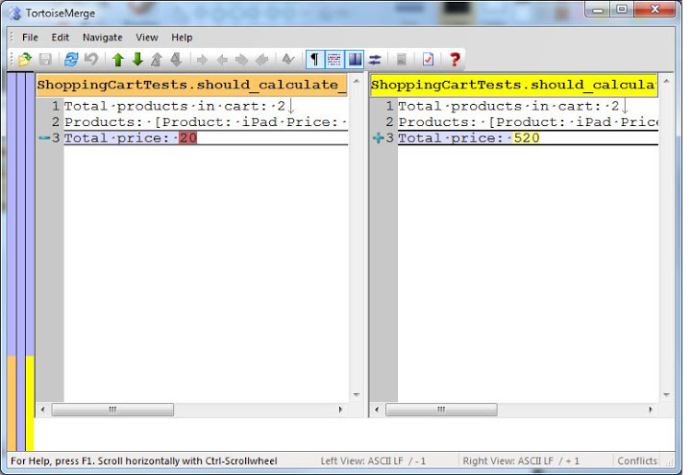
Speed
?
Notes:
(Rob)
https://www.flickr.com/photos/davidvillarreal/8732245026/
Speed vs confidence
By speed we mean speed of feedback – how quickly do we get feedback as to whether or not the codebase is ok
Confidence – how much certainty do your tests give you that your software is okay

Slide 43
Object Mother / Test Data Builder
Two powerful patterns that complement
Improves consistency, clarity of intent, tests-as-documentation, readability, maintainability
Allows you to simplify complex data setup
Tip: If you are using .NET check out TestStack.Dossier

Slide 44
Demo Test data generation example
Notes:
(Rob)

Slide 45
Questions to ask… Are you happy with amount of effort, overall confidence and speed of feedback (checks and tests)? How can you make testing simpler? How can you continuously improve your testing?
Notes:
(Matt)

Slide 46
Thankyou! Questions?
http://bit.ly/microtesting
Matt Davies
Lead Consultant, Readify
@mdaviesnet
Rob Moore
Principal Consultant, Readify
@robdmoore

Slide 47
Further reading
http://robdmoore.id.au/blog/2015/01/26/testing-i-dont-even/
http://robdmoore.id.au/blog/2013/05/26/test-data-generation-the-right-way-object-mother-test-data-builders-nsubstitute-nbuilder/
http://robdmoore.id.au/blog/2014/01/23/test-naming-automated-testing-series/
https://vimeo.com/68375232
https://vimeo.com/68390508
https://github.com/robdmoore/TestingPatternsWithDossierPresentation
https://github.com/robdmoore/SubcutaneousTestsPresentation

